Slide 1
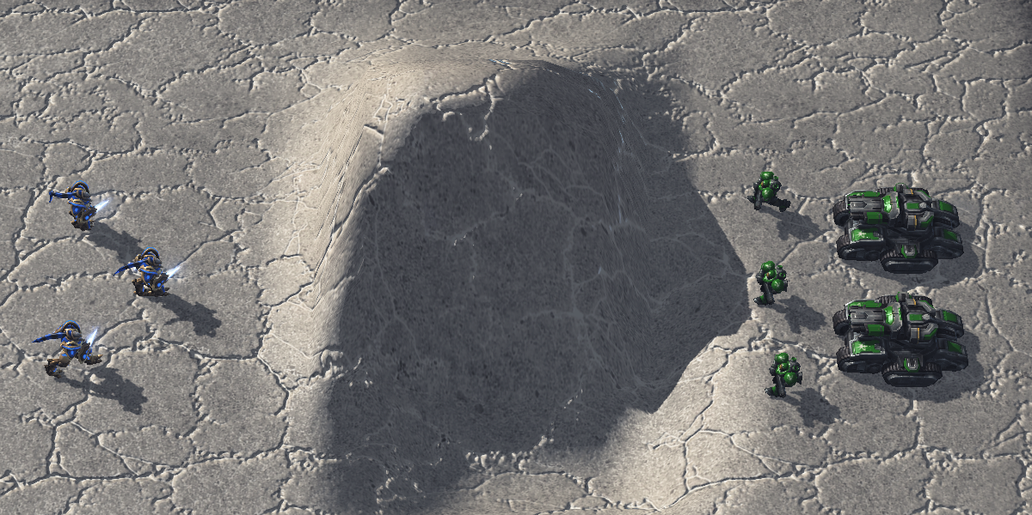
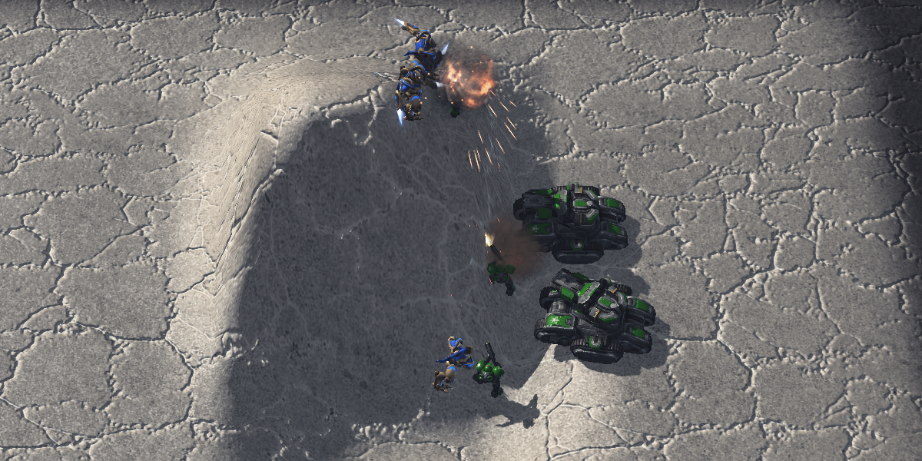
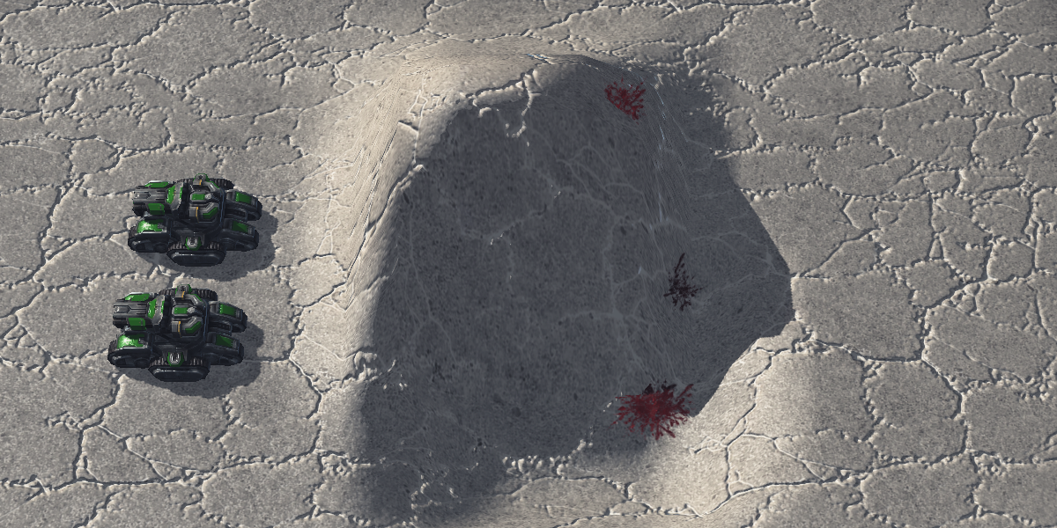
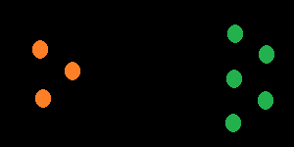
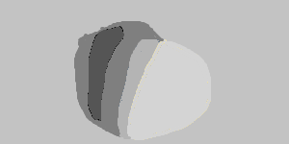
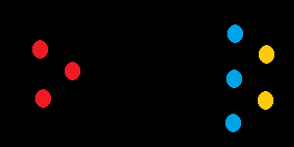

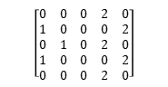
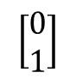
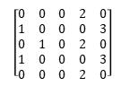

generation timeline
Combat start
Engaging armies
Finished combat
in-game view
Not needed for the classification
Player ID
Height map
Unit type
feature maps
Right side wins!
$$\left[\begin{matrix}0 & 0 & 0 & 2 & 0 \\ 1 & 0 & 0 & 0 & 2 \\ 0 & 1 & 0 & 2 & 0 \\ 1 & 0 & 0 & 0 & 2 \\ 0 & 0 & 0 & 2 & 0\end{matrix}\right]$$
$$\left[\begin{matrix}0 & 0 & 0 & 0 & 0 \\ 0 & 3 & 3 & 0 & 0 \\ 0 & 3 & 2 & −1 & 0 \\ 0 & 3 & 2 & −1 & 0 \\ 0 & 0 & 0 & 0 & 0\end{matrix}\right]$$
$$\left[\begin{matrix}0 & 0 & 0 & 2 & 0 \\ 1 & 0 & 0 & 0 & 3 \\ 0 & 1 & 0 & 2 & 0 \\ 1 & 0 & 0 & 0 & 3 \\ 0 & 0 & 0 & 2 & 0\end{matrix}\right]$$
Transform result into vector
representation
Actual classification
$$\left[\begin{matrix}0 \\ 1\end{matrix}\right]$$

Slide 2

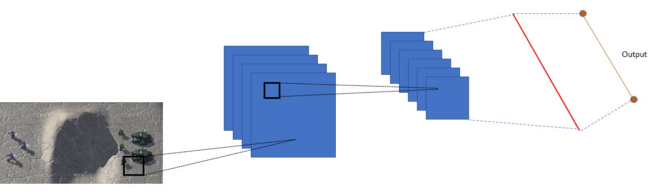

Spawn random engagement scenario
Play out engagement and save replay
Extract feature representation
.SC2Replay
Starting setup
Replay file from SC2
Train classifier
$$\left[\begin{matrix}0 \\ 1\end{matrix}\right]$$
Trained classifier
Result vector
3D Input vector

Slide 3
Input Layer
Hidden Layer
Output Layer

Slide 4
h₁
g₁
x
h₂
f
g₂
h₃

Slide 5
2 | 3 | 1 | 3
9 | 6 | 5 | 7
8 | 4 | 1 | 1
2 | 7 | 0 | 4
9 | 7
8 | 4
X
Y

Slide 6
Output

